Slide 1
Statistics
How to complete a statistics investigation

Slide 2
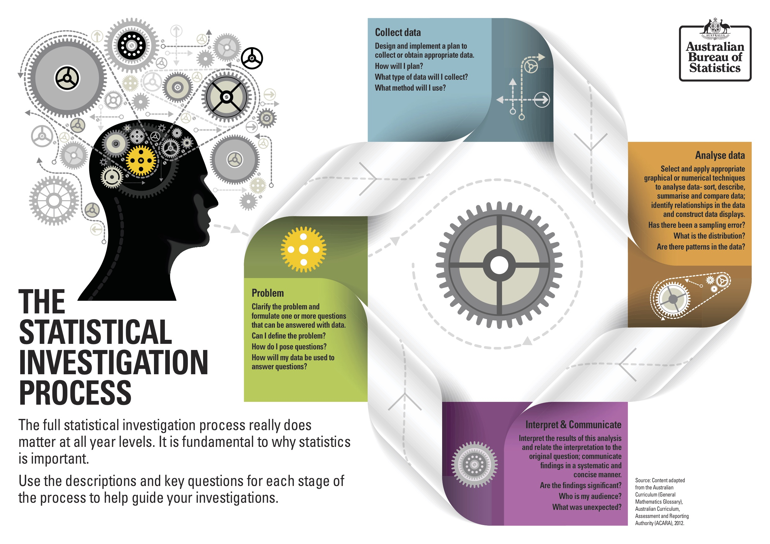

Slide 3
Sections
Introduction
Numerical Analysis
Interpretation
Conclusion

Slide 4
1. Introduction
Restate the question in your own words (shows you know what to do)
Say what you’re going to do and how you’re going to analyze and compare the data
Buzz Words!

Slide 5
2. Numerical & Graphical Analysis
Compare data sets
Identify & remove outliers
Graph(s)

Slide 6
3. Interpretation
Discuss your removal of outliers.
Discuss and compare your graphs
Association:
Trend
Strength
Form

Slide 7
4. Conclusion
Make a statement about your results and what you did
Answer the question
Use the comparison of your results to support your answer
Trend
Strength
Form

Slide 8
Your investigation report should include the following:
1. Introduction – two or three sentences providing an overview of your investigation
2. Numerical and graphical analysis
choose various statistical measures you have studied to analyse the data
consider the most appropriate graphs which represent the data provided
3. Interpretation of the results of this analysis in relation to the original question
describe any trend and pattern in your data (two to three sentences)
state how your data relates to the original problem (two to three sentences)
use your knowledge and understanding gained in this unit to explain your results in one paragraph
4. Conclusion
summarise your findings and conclusions in one paragraph.

